Slide 1
Introduction to Software Business Product management
Week 4 Day 2
Led by: Emily Crose
for
Oakland University

Slide 2
Review of day 1

Slide 3
Questions From Day 1?

Slide 4
Terms to listen for
Binaries
Executable files

Slide 5
Practicing With Git
https://learngitbranching.js.org/
Alternatives
https://gitimmersion.com/lab_01.html

Slide 6
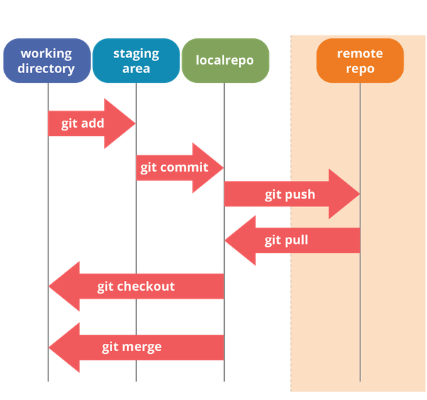
Workflow revisited
Notes:
If we go back to our workflow slide, let’s remember what we need to do before we put in our pull request

Slide 7

Branching With Teams

Slide 8
Branch Naming conventions
What type of branch naming convention works for you?
[Username] - <feature>
[Jira ticket #] - <feature>
[github issue number] – {username} - <feature>

Slide 9
Pull
Notes:
When we make changes, we need to pull those changes, especially if we’ve just merged them!

Slide 10

Forking

Slide 11
Editing a forked repository
Notes:
Practical slide – show what happens when a repository is forked

Slide 12
Pull Request

Slide 13
Code reviews
Notes:
When we add a new Pull Request, we should specify some members of our team who are capable of doing code reviews. These can just be static code reviews, they don’t need to be load-up-and-execute reviews (unless you want them to be!) How thorough you get is totally up to you!

Slide 14

Code review
Allows changes to be approved
Limits bad code merges
Adds a layer of safety
Notes:
Before we approve a pull request, we need to validate that the code is in good shape. To do this, we will review the code, and approve it. My team calls this “stamping” changes. Within git, you can change how many reviewers are needed before you can merge the changes.

Slide 15
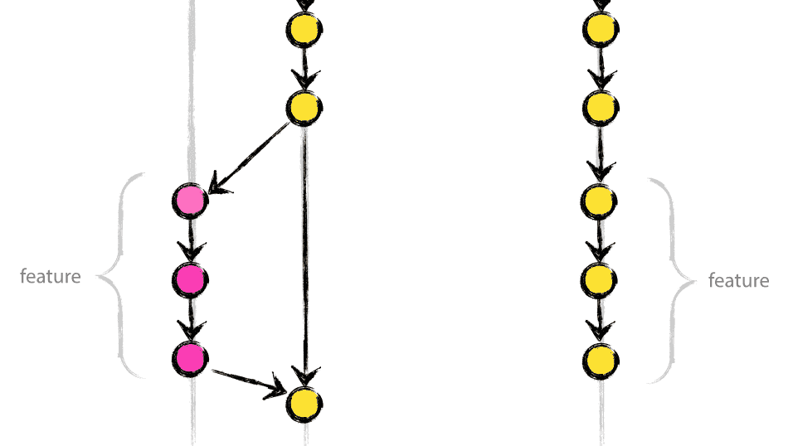
Merging Changes

Slide 16
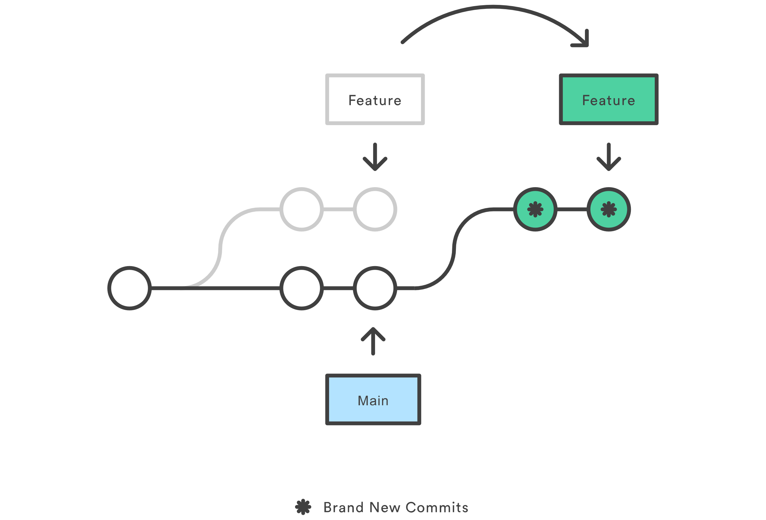
Rebasing
Notes:
Rebasing is the process of moving or combining a sequence of commits to a new base commit. Rebasing is most useful and easily visualized in the context of a feature branching workflow. The primary reason for rebasing is to maintain a linear project history. For example, consider a situation where the main branch has progressed since you started working on a feature branch.

Slide 17

Release Candidates

Slide 18

Building binaries
Notes:
Do we need to have a pipeline for building releases? This is where Jenkins may come in

Slide 19

Release Notes

Slide 20

10 minute break

Slide 21

Licensing

Slide 22

Licensing
Software can be copyrighted
How do we protect our “Intellectual Property”?

Slide 23
Broad categories of software licensing
Weak Copyleft
Copyleft
Commercial or Proprietary
Dual
Public Domain

Slide 24

Permissive
Permissive
Minimally restrictive on modifications or redistribution
Typically, only require acknowledgements

Slide 25


Weak Copyleft
Allows linking to open source libraries
Minimal requirements
Modifying the library is more complicated than permissive
Examples:
Gnu Lesser General Public License (GLPL)
Mozilla Public License (MPL)
CDDL
Eclipse

Slide 26

Copyleft
A.K.A. “Reciprocal” licenses or “Restrictive” licenses
Not as commercially friendly
Requires publication of source code for derivative works
Not good for commercial products!
Examples:
Gnu Public License (GPL)

Slide 27


Commercial/Proprietary
Most restrictive
Typically used by corporations
Typically closed source

Slide 28

Dual
Differs for different types of users
Examples:
Server-Side Public License (SSPL)

Slide 29

Public Domain
Copyright protections do not apply
Hard to find software in this category
Most permissive

Slide 30

Unlicensed
Can be complicated
Can be legally risk
Notes:
For companies to use this, they will need to request a license to be applied to the software work. It can be complicated to use unlicensed works if there’s no explicit license attached to it.

Slide 31

Licensing concerns
Notes:
You need to concern yourself with licensing types, and how they might impact you. For example, you may be building software using a library that relies on a license that does not allow for commercial use.

Slide 32

Architecture Design

Slide 33
10 minute break

Slide 34

Functional Testing

Slide 35
Manual testing?
Takes longer
Not scalable
Tedious!

Slide 36
Automated Testing
What does our testing pipeline look like from an architecture perspective?
What types of tests do we need to perform?
Regression testing
QA testing
User Acceptance Testing
Load testing
Performance Testing
Security Testing

Slide 37
Testing In Depth
Load Testing
Stress Testing
Performance Testing
Security Testing

Slide 38
Unit Testing
We added a feature!
Does it do what it’s supposed to do?
This should be done for every new feature!

Slide 39
Load Testing
Average number of concurrent users in the tool at a time
Beneath “peak” use
This is the REGULAR amount of traffic you expect to get
Does our app scale with more users?
We can test for this!
Notes:
Load testing tests the number of users or “average load” of requests a server can expect in its regular routine.

Slide 40

Stress testing
ABOVE average use
Uncommon amount of traffic
Can we load balance?

Slide 41

Performance Testing
How quickly can we load information?
Do we see any lags in transfer under regular use?
Lags in higher-than-average use?

Slide 42

Security testing
How can we break this app?
Can we get access we shouldn’t have?
Can we get information we shouldn’t have?
Can we make the app do something unexpected?
Do we need to fully pentest this app?

Slide 43

Pentesting?
Can we do this “in-house”?
Is there a cost associated with this?
Probably!
Is doing a pentest worth the cost?
What if we don’t do a pentest?

Slide 44
Product pentesting options
In-house pentest
Do we have the expertise to do this in-house?
Third-party testing
Is there a legal or regulatory reason we should do a third-party pentest?

Slide 45
Architecture pentesting
Should we pentest our back-end architecture?
Is there a cost associated with this?
Probably!

Slide 46
Outcomes from testing
Bug tickets
Feature Requests
Reporting
We can show this to regulators!

Slide 47

Session Review

Slide 48
Question or clarifications?

Slide 49
See you next time!

